Slide 1
CSS MILESTONE
GROUP 1

Slide 2
TABLE OF CONTENT
01
04
02
05
03
06
GIT Changes
1980-1990 Template
Index Page
1991-2001 Template
1968-1979 Template
2002-2012 Template
07
2013-2023 Template

Slide 3

Team
We are delighted with the collaborative efforts of the entire team and wish to express our gratitude to our CSS managers for their exceptional work.
Their contributions were instrumental, and without them, achieving completion of the CSS today would not have been possible.

Slide 4
01
GIT Changes

Slide 5
New Directory Tree
GROUP_1
docs
html
resources
styles
templates
general
how-to
Summaries
Directories sames as html
Clock
1968-1979
1980-1990
1991-2001
2002-2012
2013-2023
main

Slide 6
02
Index Page

Slide 7
Templates
Inspiration
Universal
Every template is inspired based on a different year span
Collaboration
Fully adaptable to the specific needs of each subgroup.
The CSS leader collaborated and crafted the optimal template

Slide 8
03
1968-1979 Template

Slide 9
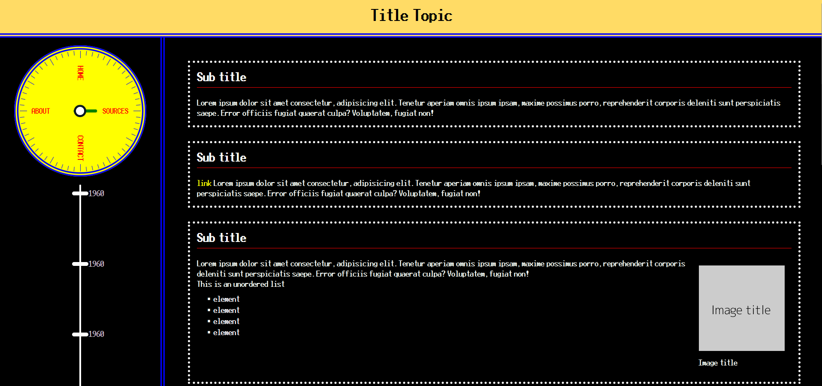

Slide 10
04
1980-1990 Template

Slide 11
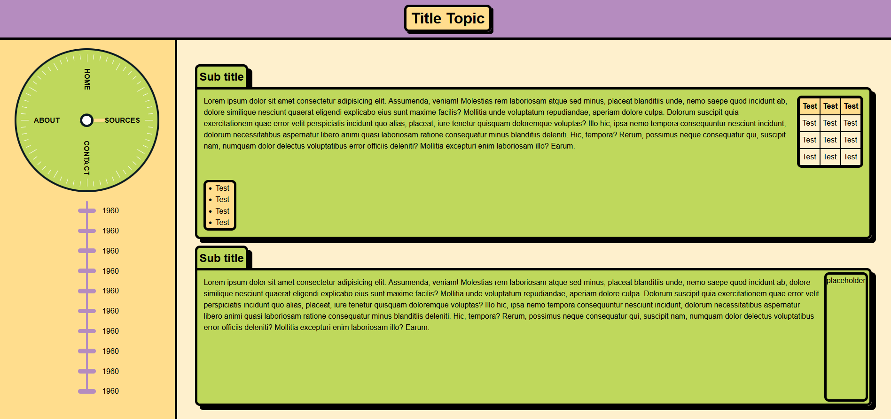

Slide 12
05
1991-2001 Template

Slide 13
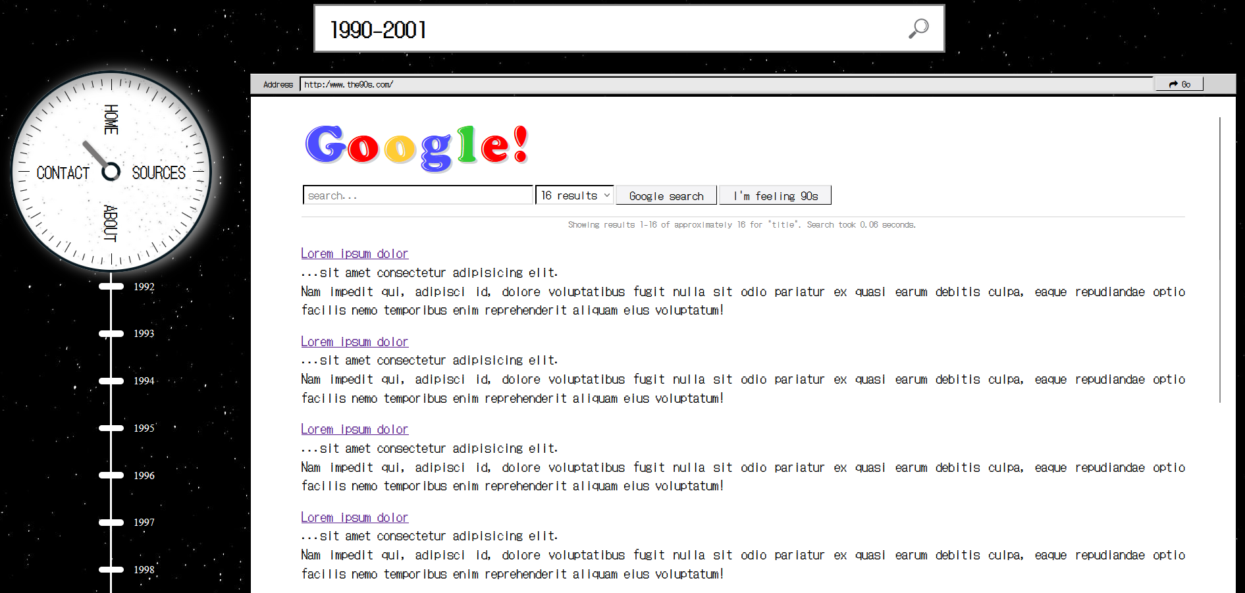

Slide 14
06
2002-2012 Template

Slide 15
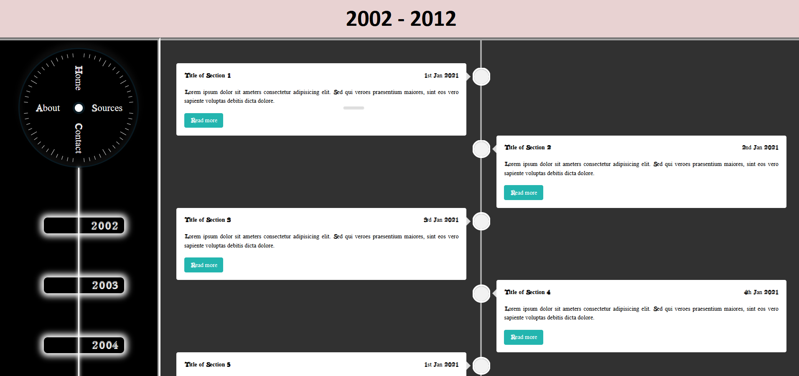

Slide 16
06
2013-2023 Template

Slide 17
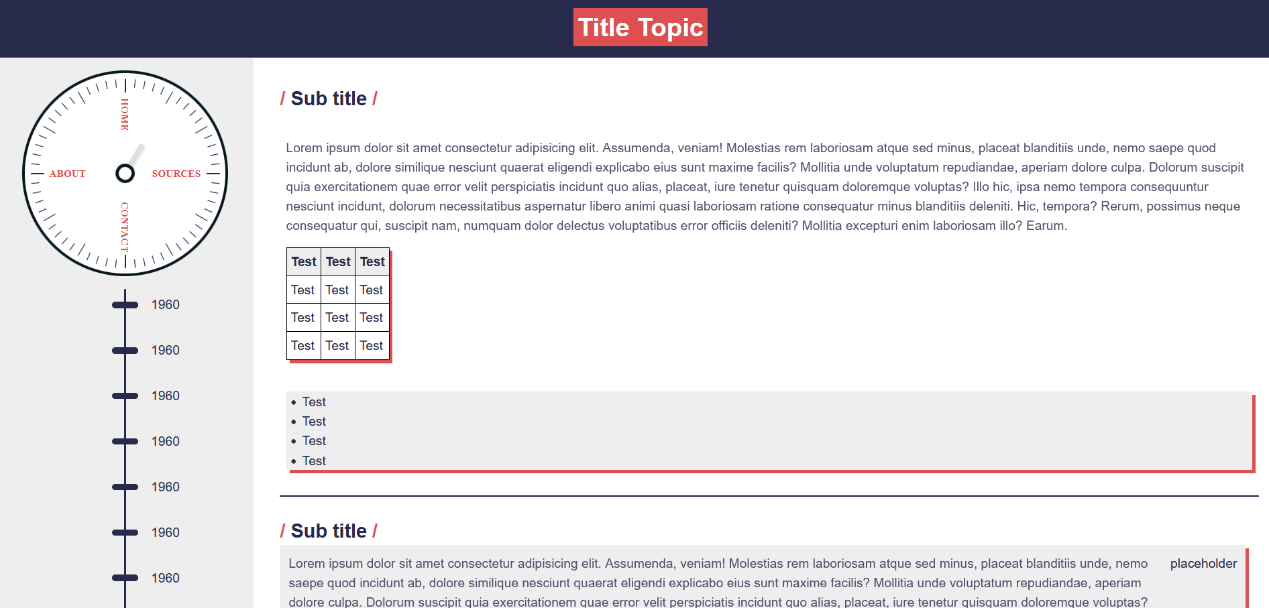

Slide 18
Professor’s Considerations

